Slide 1
The 8th grade community project
IB Coordinator- Dr. Kellie Ramsey
Parents as Partners – A.B.G.S Media Center
December 8, 2022, 6 PM

Slide 2
Alverta B. Gray Schultz is an authorized I.B World school!
One of the requirements of an I.B World School is the M.Y.P Eighth Grade Community Project.

Slide 3
Service learning is at the heart of I.B philosophy
Service learning involves using the skills & concepts learned in class and applying them to a project which promotes student awareness and civic responsibility for community initiatives.

Slide 4
​
ACTION
REFLECTION
INQUIRY
.

Slide 5
m.y.p I.B. Community project deadlines
INVESTIGATING
Select a mentor.
Determine a need in community & a goal to address the need.
Meet with mentor to review & discuss items listed in the investigating phase.
October to November, 2022
November to December, 2022
PLANNING
Develop a plan of action & record information in process journal.
Continue research.
Complete the proposal for action.
January to March, 2023
TAKING ACTION
Carry out the service project and record information in process journal.
April, 2023
REFLECTING
Self-evaluate your project & learning.
Complete academic honesty form.
Prepare your oral presentation.
Prepare your tri-fold project board
Discuss oral presentation with mentor.

Slide 6
Parental takeaways
1.
Your Scholar received their project guide through their Individuals & Societies teacher. Copies of the I.B M.Y.P Community Project Guide will be available in English or Spanish on paper or on Schoology.
2.
Their project will be guided by a mentor but independently completed by the 8th grade scholar. Scholars must commit a minimum of 15 hours total to completion of this service project.
3.
Your scholar will maintain a Community Project Process Journal as they complete the project. A minimum of six entries is required (includes notes, reflections revisions, frustrations).
4.
As a school community we will proudly celebrate their culminating 8th Grade M.Y.P Community Project on May 24, 2023!

Slide 7
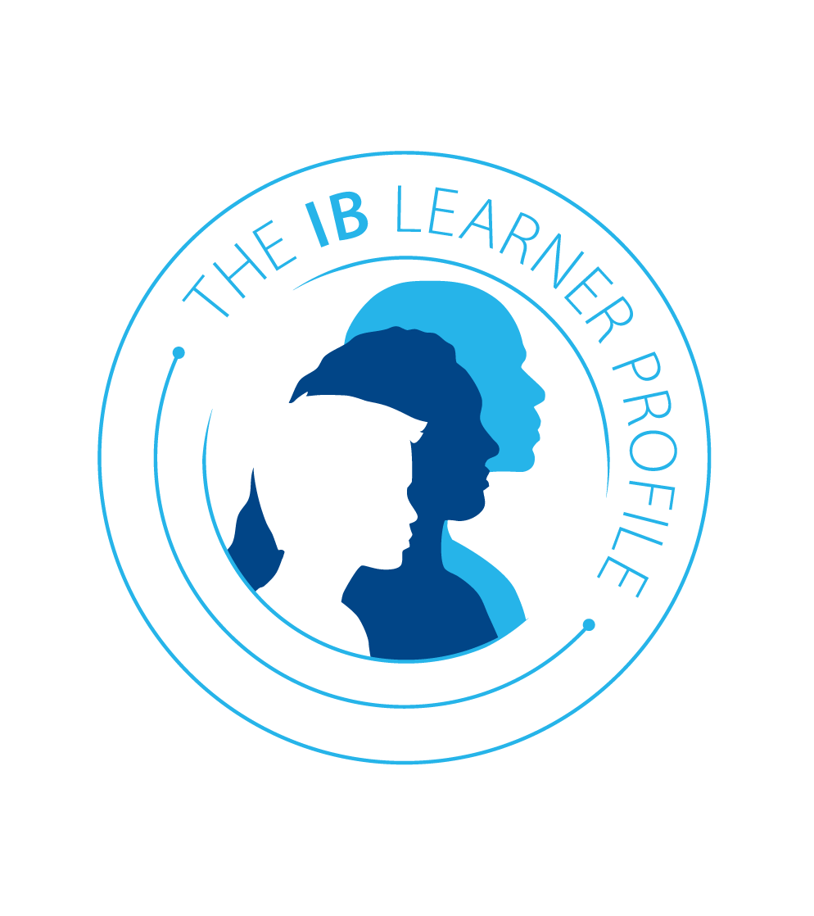
Questions/comments about the I.B M.Y.P 8th Grade Community Project?
Interested in learning more about the MYP? please visit the IB website: www.ibo.org/myp

Slide 8
THANK YOU
Any additional questions/concerns @ the project please send to:
Dr. Kellie Ramsey
Interim IB Coordinator
kramsey@hempsteadschools.org
(516)434-4304
Individuals & Societies I.B Coach- Mrs. Dawn Sumner
Dsumner@hempsteadschools.org

